Slide 1

FACEBOOK CLONE
Developed By:
S Akhilesh
Asutosh Padhiary
Asish Mohanty

Slide 2
INTRODUCTION
Definition:
  Facebook is a social networking site that makes it easy for you to connect and share with family and friends online. Originally designed for college students, Facebook was created in 2004 by Mark Zuckerberg.
FB Clone involves:
  Updating the personal info
  Connecting with family and friends
  Adding new pictures
  Updating the status

Slide 3
ABOUT
This 2022 Facebook Clone in React And Firebase was created using the JS and CSS.
It is a simple and basic level little project for learning purposes. We can also modify this system to meet our needs and create a fantastic advanced level project.
A JS code for a Facebook Clone allows us to keep track of social life and manage them as needed.

Slide 4
MOTIVATION
To get an hands-on experience about React-JS and Firebase.
To get to know about different functionalities required for developing a social media platform.

Slide 5
PREREQUISITES
Access and knowledge of any text editor (such as Atom or Visual Studio Code)
  A terminal
  A server to run
General knowledge of React and JavaScript
Material UI
Firebase

Slide 6
WORKFLOW
Step 1: Creating the React App
Step 2: Installing Material UI
Step 3: Setting up the Firebase
Step 4: Facebook for Developers Setup

Slide 7
MAJOR FUNCTIONALITIES / FEATURES
User Login– In this feature the user can login using their original Facebook account.
Updating Personal Information – In this feature the user can update his/her personal information.
Updating the Status– In this feature the user can post the thoughts in their mind.
Adding Images– In this feature the user can share the memories in the form of images.

Slide 8
ARCHITECTURE OF FB CLONE
Home Page
User Login
Updating
the status
Adding Images

Slide 9
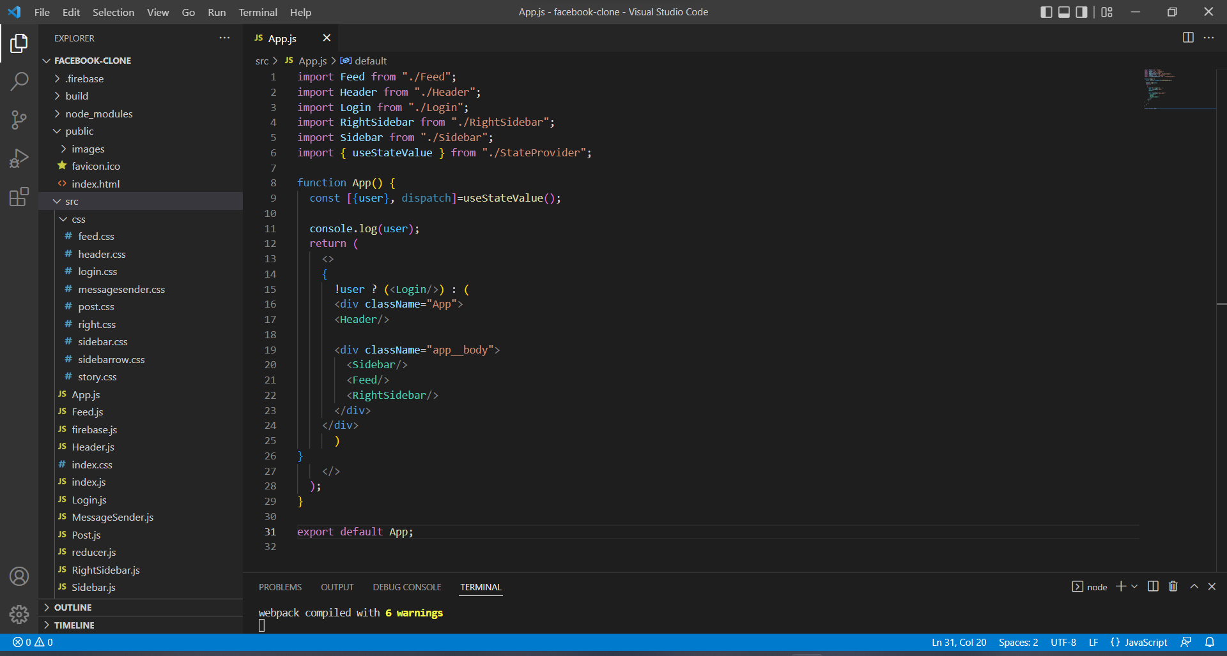
SCREEN SHOT OF THE VS CODE PAGE CONTAINING ALL THE DIFFERENT MODULES
Screen Name
Mode of the
Screen

Slide 10
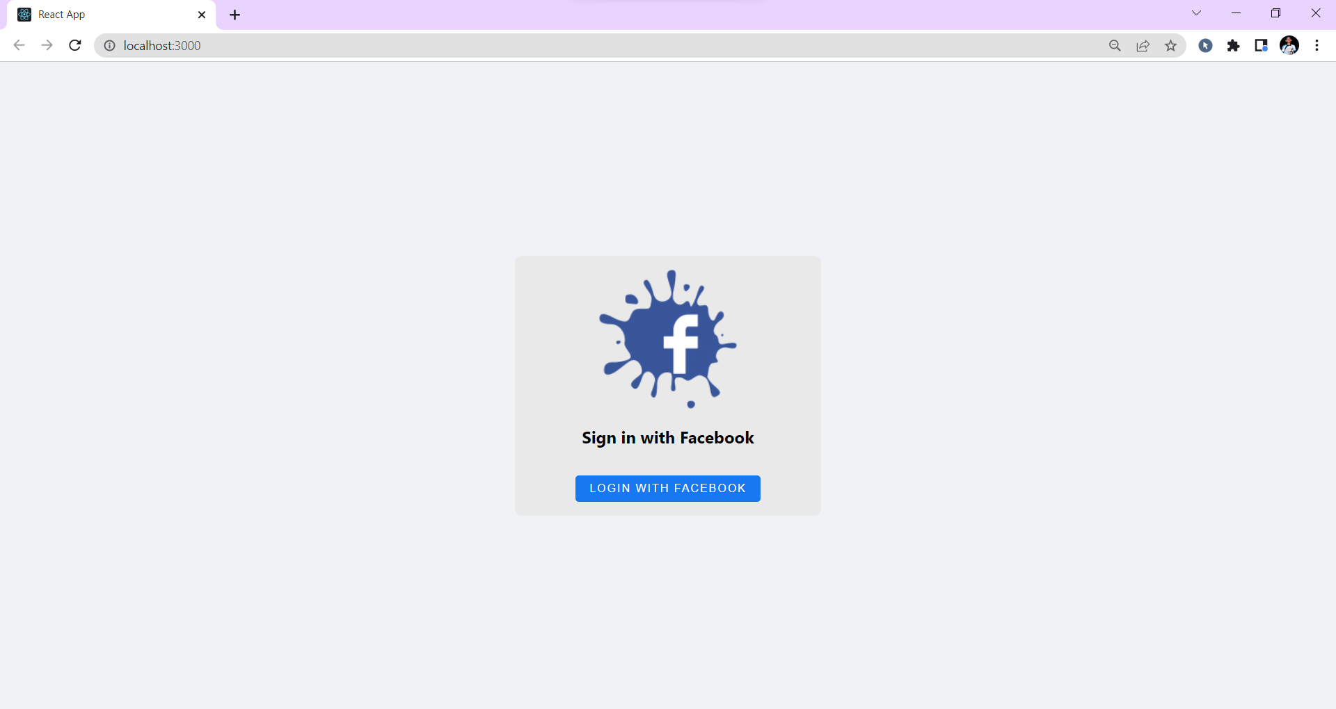
SCREEN SHOT OF THE LOGIN PAGE

Slide 11
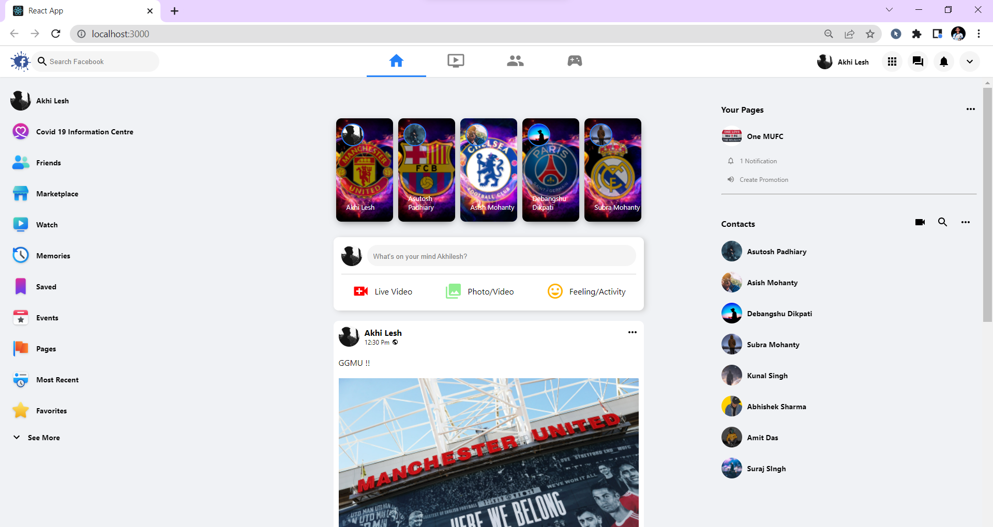
SCREEN SHOT OF THE HOME PAGE

Slide 12
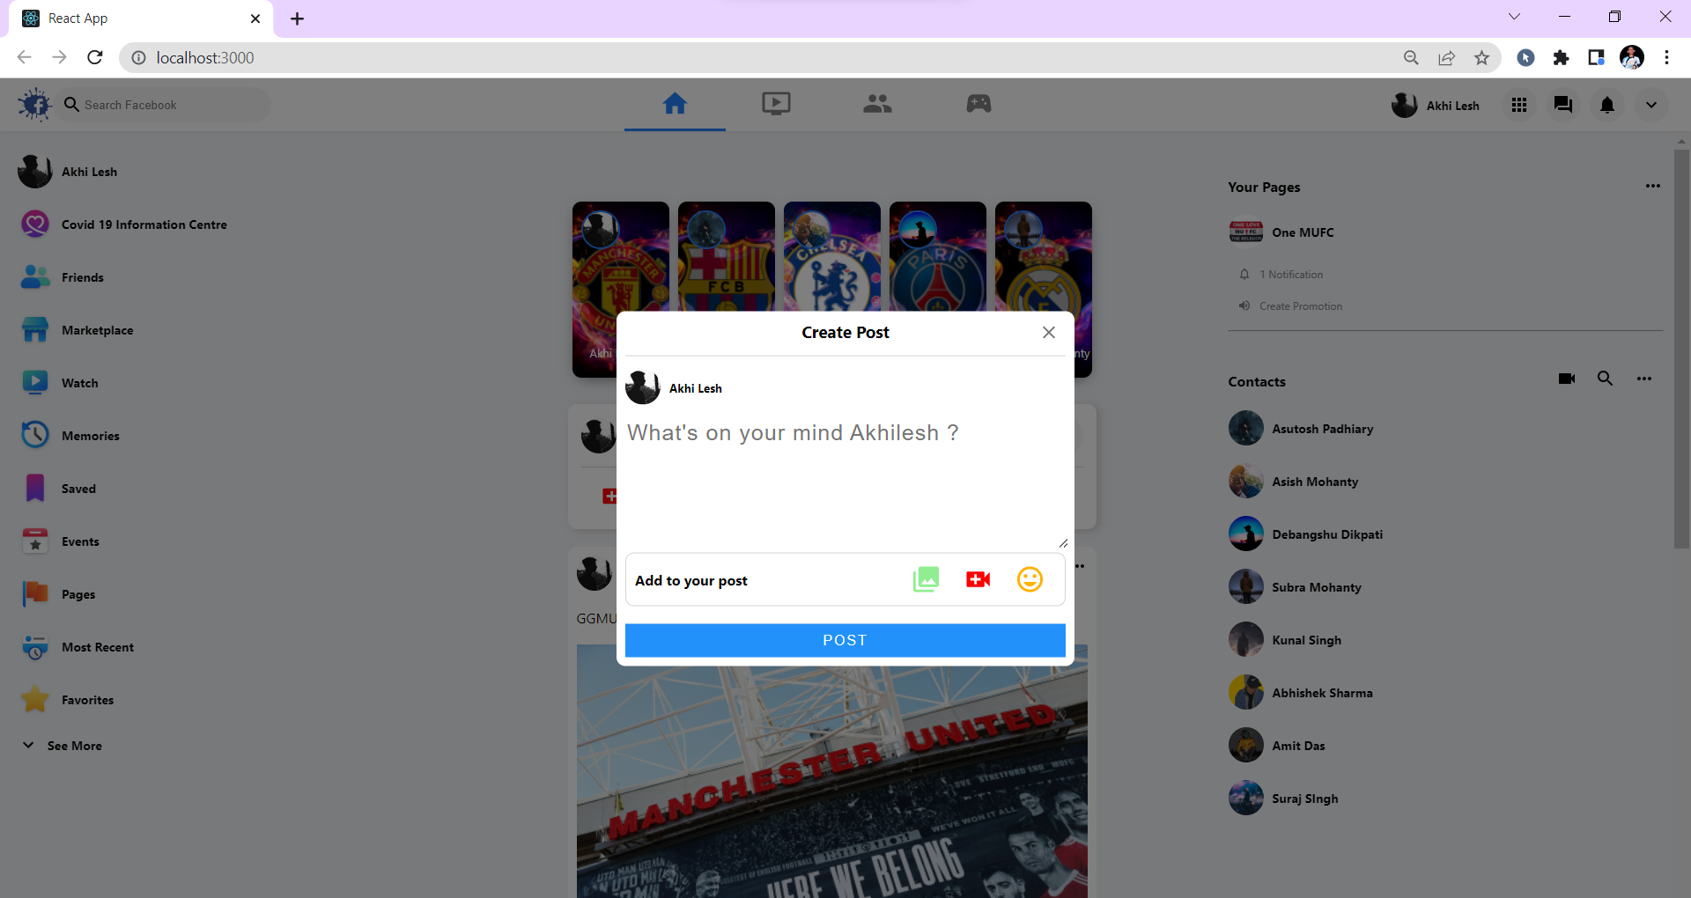
SCREEN SHOT SHOWING THE CREATE POST POP-UP

Slide 13
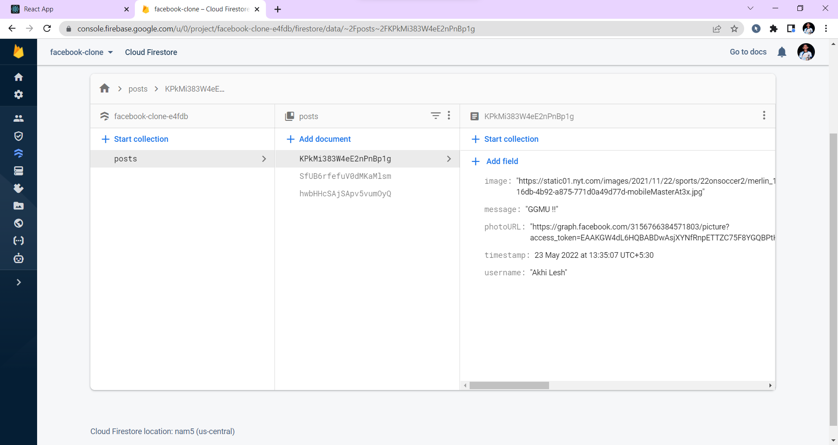
SCREEN SHOT OF DATA GETTING STORED IN THE FIREBASE

Slide 14
CONCLUSION
In conclusion, Facebook plays many vital roles in order to connect people in the world without boundary because almost every people these days are familiar with Facebook .This gave us the opportunity to know more about the work flow of the project by simply running it on the http://localhost:3000/ server.
We were able to build your own social medial clone app with real-time uploading capabilities and since we used Firebase, no backend coding is required.

Slide 15
OTHER POSSIBLE MODULES
  Youtube
  Instagram
  Amazon
  Spotify
  Etc.

Slide 16


